Slide 1
Ocean Cannabis
The Twin Harbor's Most resource full Cannabis Collective are diligently educating Patrons, being dedicated to the cannabis patients and we pride ourselves in giving the highest levels of Services in the harbor...

Slide 2
OCEAN CANNABIS MISSION
It is our organizations life commitment is to provide safe, secure, quality medicine to our members,, and to provide accurate education. We are dedicated to resolving problems and being genuinely committed to our patients, their families, & their providers. We are compliant with RCW 69.51A. All patients and providers must be a qualified member to our organization.

Slide 3
The Gardeners Behind Ocean Cannabis
President/Treasurer
Vice President/Secretary
David E. Archer
Mr. Archer has been a medical cannabis advocate for several years. With his IT expertise and his undying compassion for cannabis he is a the perfect addition to the Cannabis Communities. He is dedicated to education of cannabis and revolutionizing the industry, especially in the current technical environment and its resources for cannabis.
Stephanie a. Cummings
Miss Cummings is newer to the cannabis community but is skilled in health care, law, and arts. With her skills and thirst to learn she makes a good asset to the team with the mission to grow and teach. Miss Cummings dedicated her time to learning what is and isn't available to those with medical cannabis in Washington State.

Slide 4


Miss Stephanie Cummings
Mr. David Archer

Slide 5
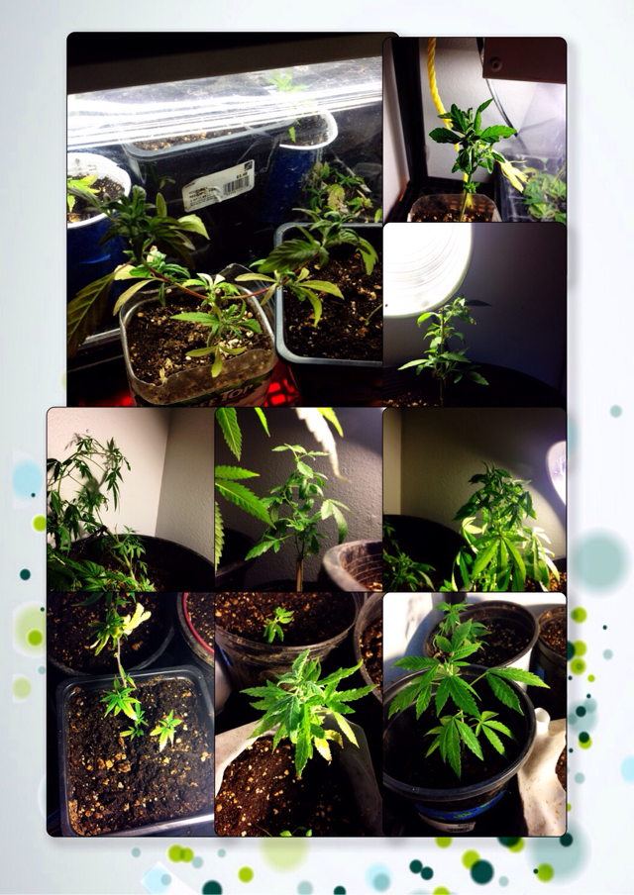
Ocean Cannabis Nursery
This is a collage of the garden started in Aberdeen, WA.

